Slide 1
Mevod’s Market Expansion Strategy
Junxi Wang
https://github.com/roverJX/DABC-Marketing-Analytics-Final

Slide 2
/01
Case Overview
/02
Exploratory Data Analysis
AGENDA
Segmentation & Targeting
/03
/04
Allocation & Attribution
/05
Customer Churn

Slide 3
Case Overview
Exploratory Data Analysis
Segmentation & Targeting
Allocation & Attribution
Customer Churn
/01

Slide 4
Executive Summary
1. Targeting the highest-values customer segment in Mevod, and providing high quality contents to advanced internet subscribers.
2. Focus on exclusive contents, mainly comedy and drama.
3. Facebook, search, and Pinterest are the three lowest CAC channels.
4. Mevod should make discount offer to everyone due to short account life and low net revenue

Slide 5
Mevod’s Current Strategy
Mevod’s current and potential competitors include Starz, an American OTT service company, and HBO. Unlike these foreign companies that treating the region as a secondary market, Mevod would like to tailored to the Middle Eastern / Arabic-speaking market.
Current Plan:
Acquiring and producing native content
Offering better customer service to establish reputation in the region
Mevod offers 4-month-bill cycle subscription model with 6 different pricing scenarios
No trial fee
Discounted trial fee
7-day trial fee
14-day trial fee
Low priced monthly plan
high priced monthly plan

Slide 6
Case Overview
Exploratory Data Analysis
Segmentation & Targeting
Allocation & Attribution
Customer Churn
/02

Slide 7
Data Overview
Key Datasets
Channel Spend
Subscribers
Engagement
Customer_Service_rep
Total spend per select channels per month, 2019/07- 2020/04
Past or current subscribers' records include data such as characteristics and demographics
Product usage data measures the product engagement of a given subscriber in a given date
Customer service representative data set include records of customer service representative who serves multiple subscribers.

Slide 8
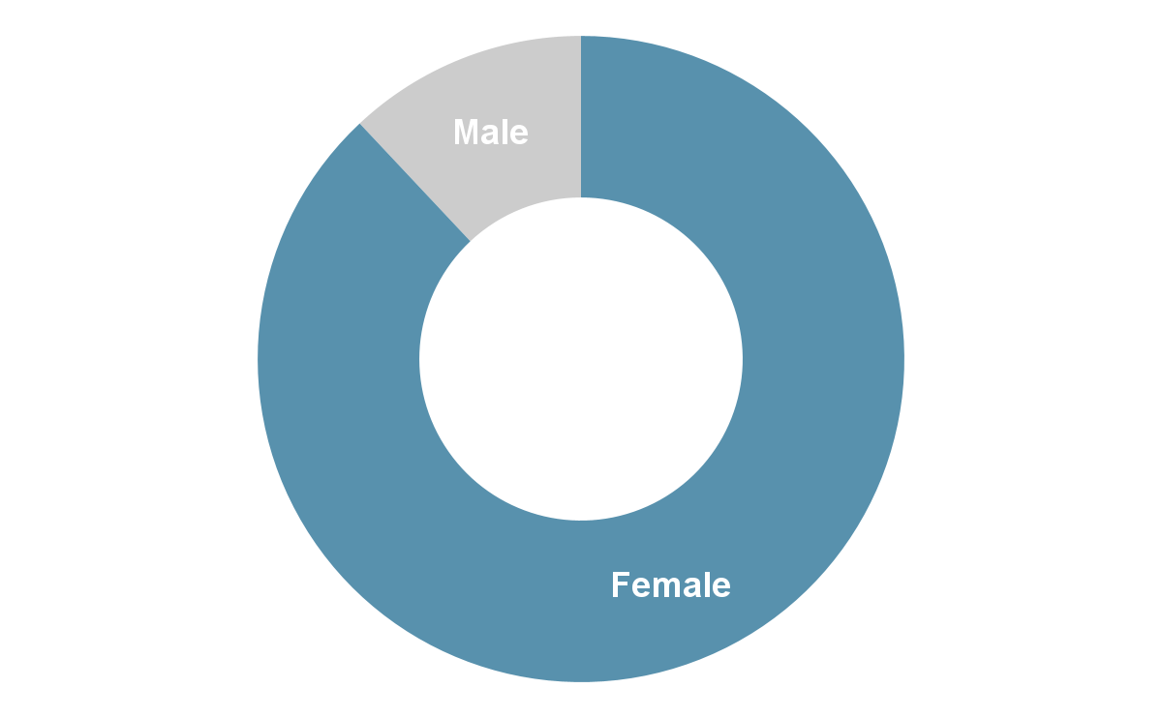
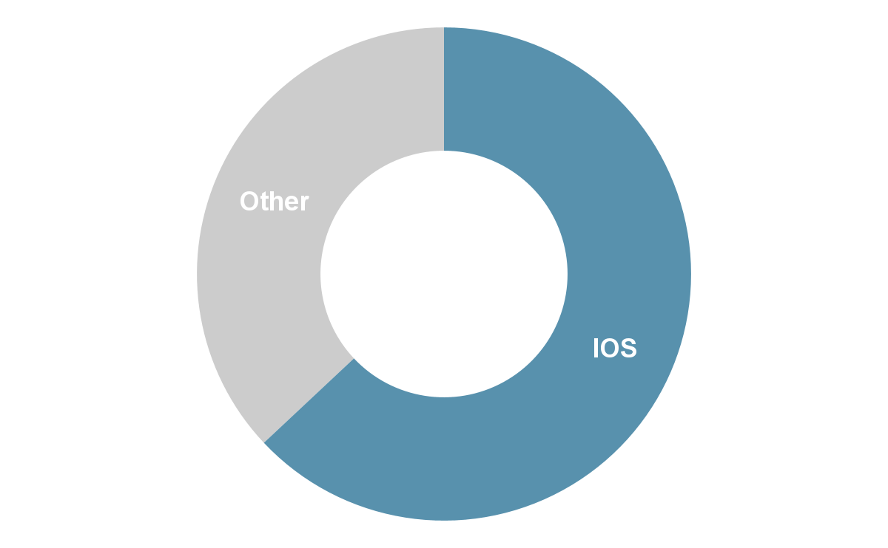
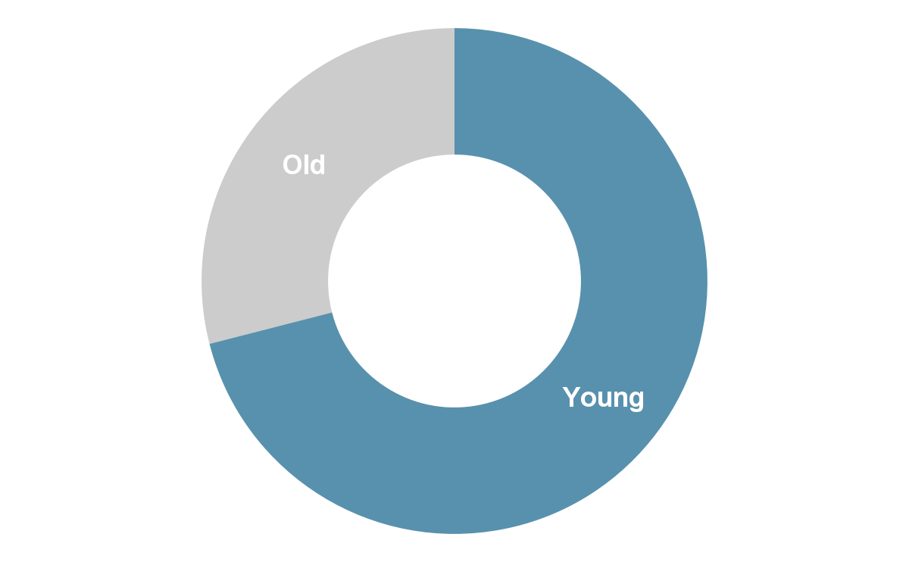
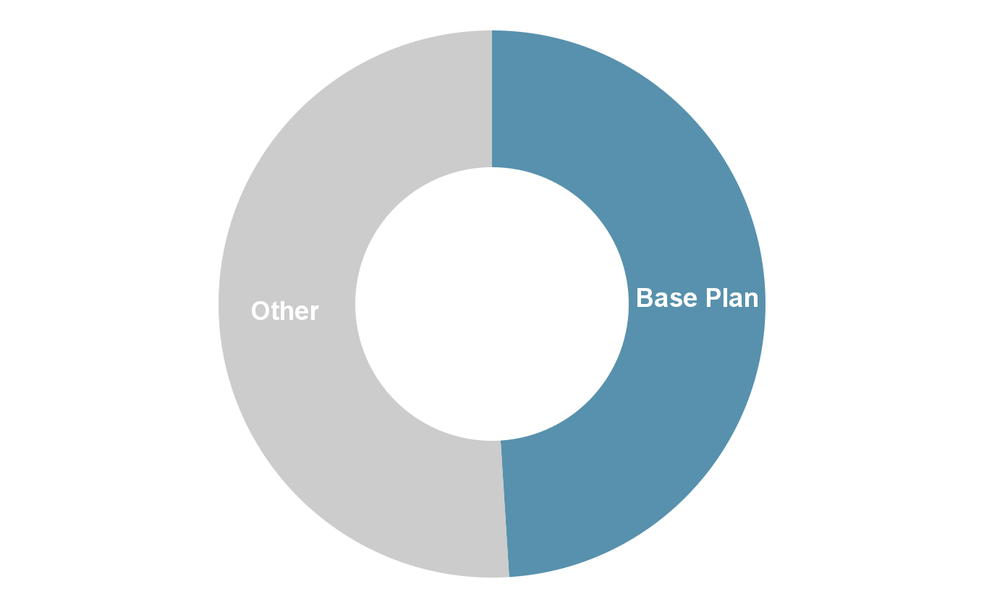
Data Overview
Subscriber Demographics
88% are Female
63% are IOS Users
71% are Young and Middle Age Adults
49% are Base Internet Plan Users

Slide 9
Understand Our Customers
There are 17 SDGs and 169 targets in total. While they are all important and interrelated, some will be more relevant to your business than others.
28 hours
Average weekly consumption hour of all customers
3 Currently Utilized Service
Average weekly number of service currently utilized for all customers
2 ideal streaming service
Average ideal number of streaming services wanted for all customers

Slide 10
Payments Data Overview
92%
Users made successful payments
65%
Users finished trial without cancellation
3.9%
Users request refund after trial

Slide 11
Case Overview
Exploratory Data Analysis
Segmentation & Targeting
Allocation & Attribution
Customer Churn
/03

Slide 12
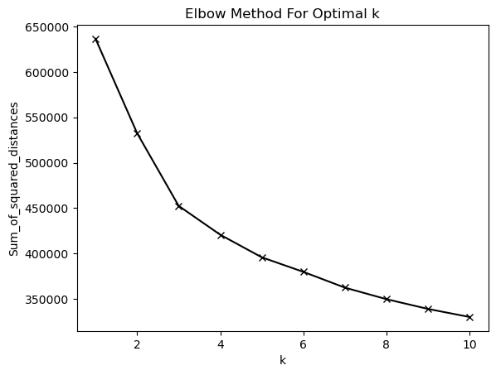
Segmentation using K-means model
Data Preprocessing
1. Unreasonable data points and null values are removed
2. Categorical variables are dummied for modeling
3. Standard scaler to numerical features for modeling
k=3
Features Used
1. Age: 16-100
2. Weekly Consumption Hour: 1-77 hours/week
3. Gender: Female, Male
4. Operation System: Android, iOS
5. Internet Package Type: Base, Economy, Enhanced
6. Preferred Genre: Comedy, Drama, Regional, International, Other
7. Intend Use: Access to exclusive content, Replace OTT, Supplement OTT, Expand regional access, Expand international access, Education, Other
Elbow Method
1. k=3 indicates the turning point from a steep to a flat slop3, therefore there will be 3 clusters of customers

Slide 13
3 customer segments
Segment 1 | Segment 2 | Segment 3
Age 25-40 Female | Age of 41-55, A mix of male and female | Age of 56-74 Mostly female
Only watch comedy Intend usage is to replace OTT, but also to our exclusive content | Watch comedy and some drama Intend to access to exclusive content | Watch comedy and drama Intend to access to exclusive content
Weekly spend 25+ hours on our service on average | Weekly spend 35+ hours on our service on average | Weekly spend 25+ hours on our service on average.
Mainly target to segment 2 because Mevod has more customers in this group, and these people also spend more time on Mevod on a weekly basis compared to other segments.

Slide 14
Marketing Strategy targeting segment 2
Advanced quality videos
Content Genre
Exclusive content
Maintain position as OTT service
Provide 4K resolution videos to the enhanced internet plan subscribers, as better quality products would keep customers.
Focus on drama and comedy
As the most unique and special feature to an OTT platform. Mevod should focus on producing more exclusive contents
Keep subscribers' main streaming service as Mevod instead of a supplement

Slide 15
Case Overview
Exploratory Data Analysis
Segmentation & Targeting
Allocation & Attribution
Customer Churn
/04

Slide 16
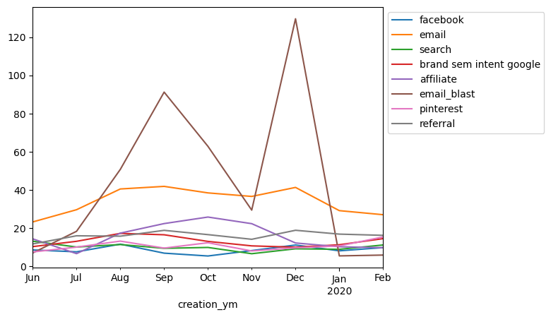
Attribution & Allocation
Top 3 efficient channels
1. Facebook – 8.6
2. Search – 10.0
3. Pinterest – 10.7
To get more customer, Mevod should focus on most efficient channels on acquiring customers like Facebook, web search and Pinterest.
CAC varies by month, therefore channels can be chosen by seasonality; Need to make sure switch cost between channels is small enough

Slide 17
Case Overview
Exploratory Data Analysis
Segmentation & Targeting
Allocation & Attribution
Customer Churn
/05

Slide 18
Customer Churn
Features
Preprocessing
Models
1. Payment period
2. Number of weekly services utilized
3. Weekly consumption hour
4. Join Fee: 0-0.73
5. Monthly_Price
6. Gender
7. Retarget customer
8. Operation System
9. Genre
10. Intend Use
11. Internet Package Type
12. Engagement features
Unreasonable data points are removed
Categorical variables are dummied for modeling
Linear regression
Logistic regression

Slide 19
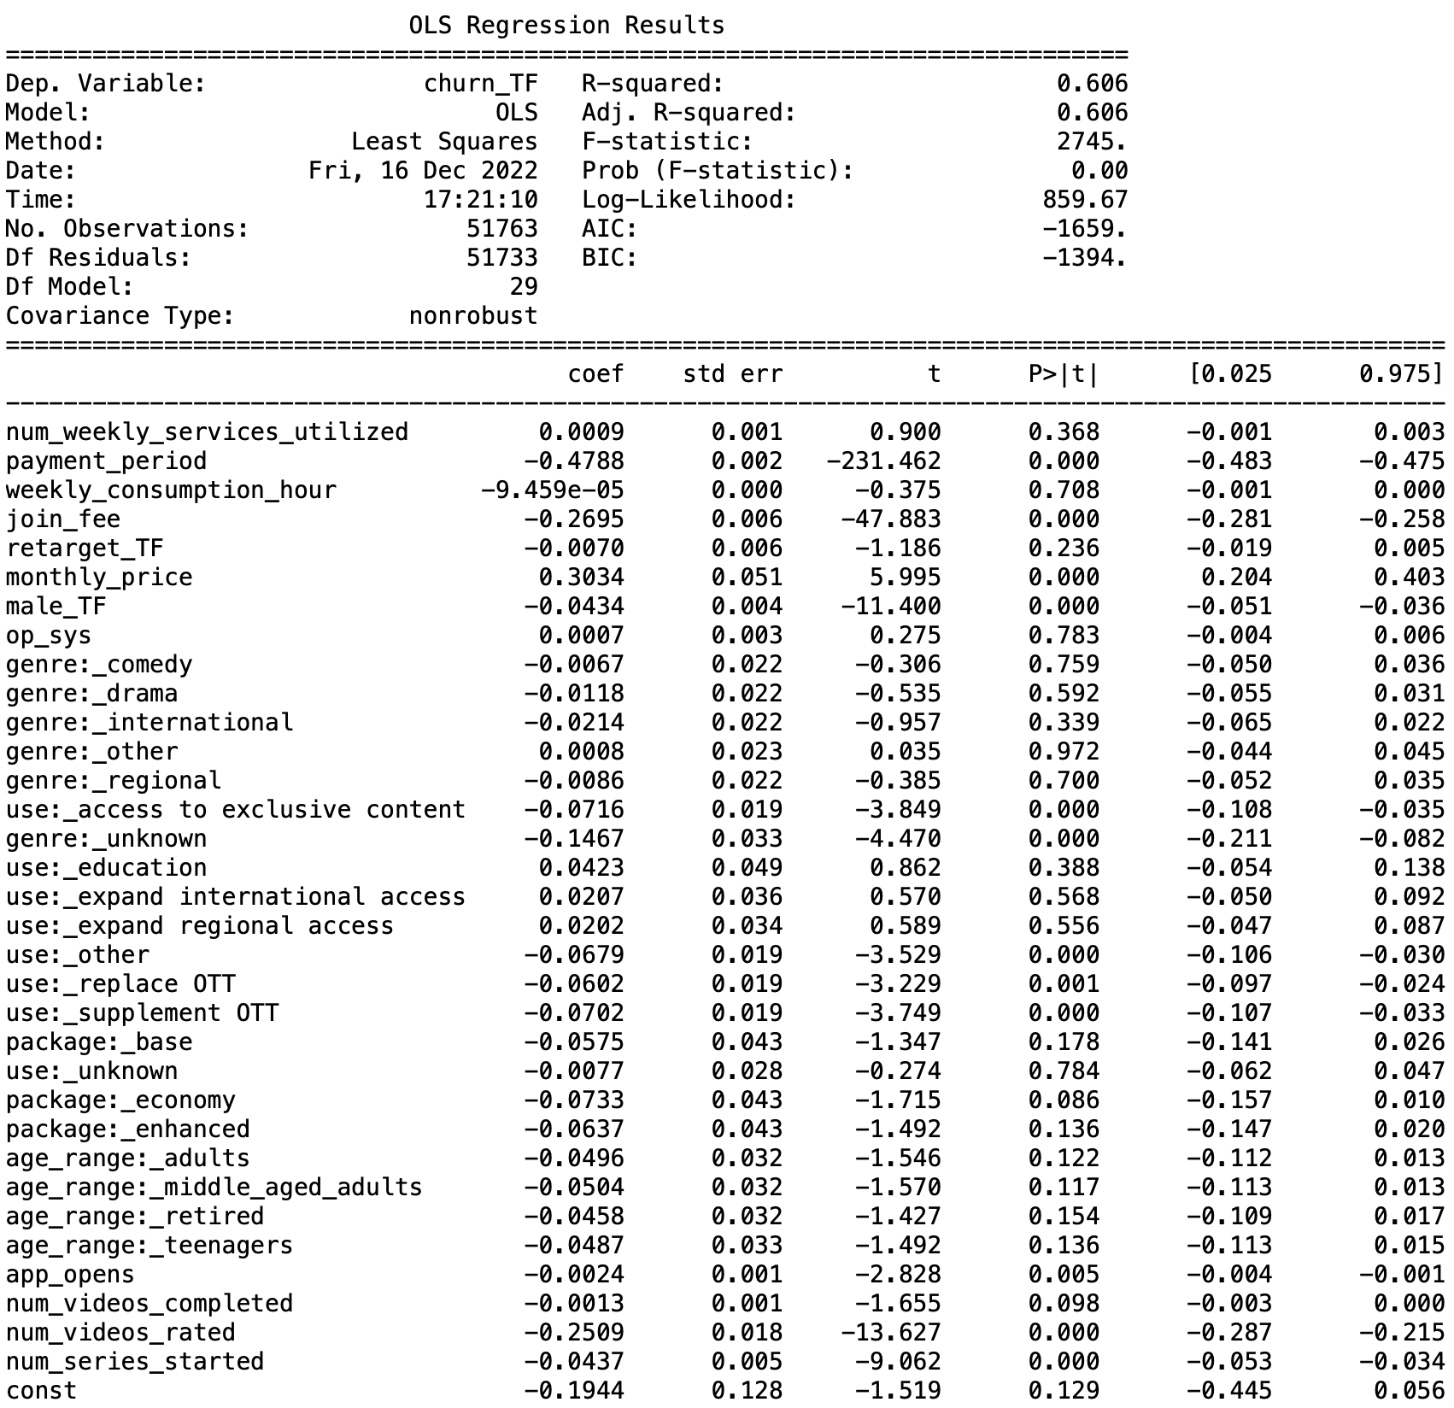
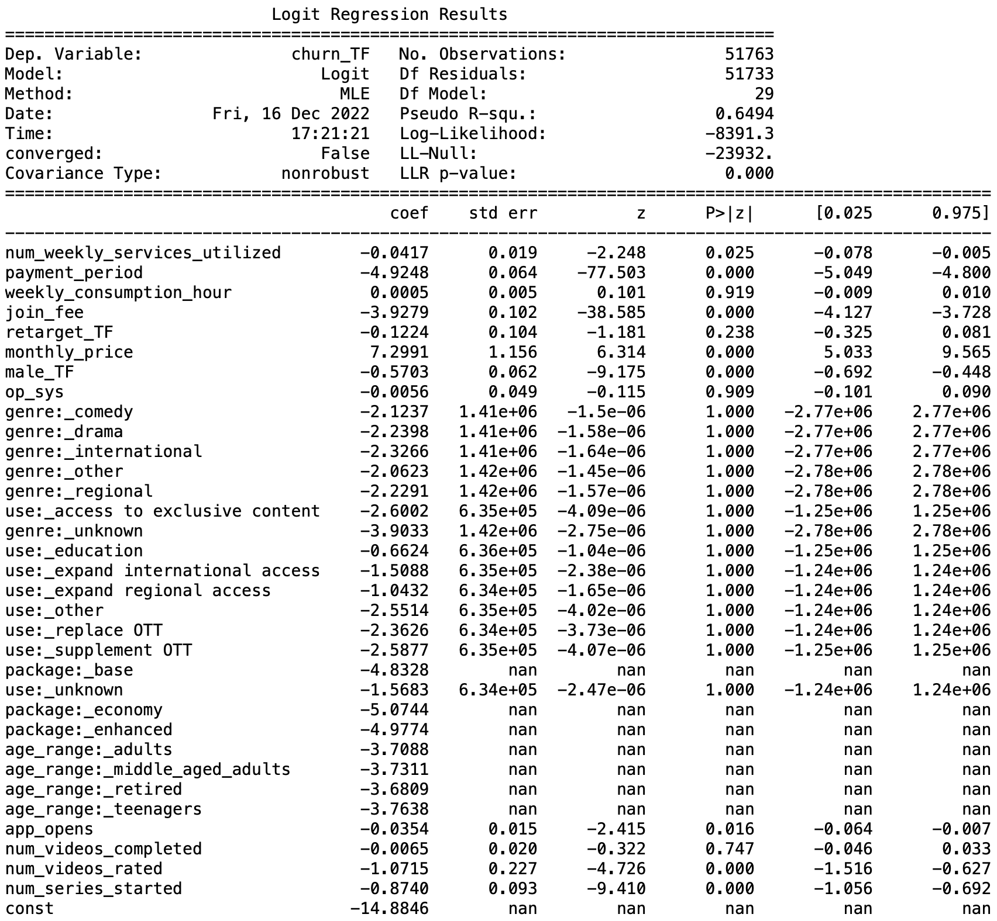
Linear regression vs. Logistic regression

Slide 20
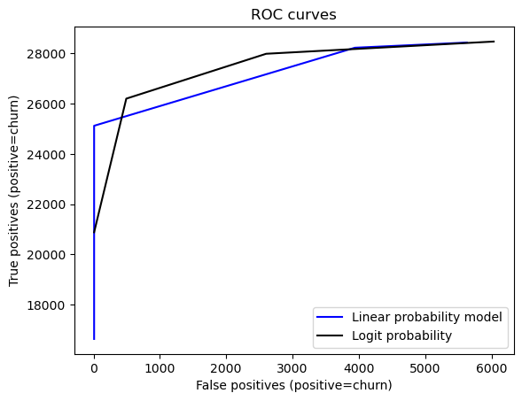
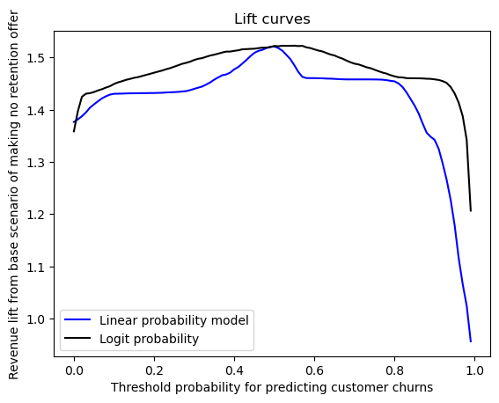
Model performance
Logit model is better than Linear model as shown by ROC curve
When Threshold=0.5, we have the highest lift (150%) from the base scenario

Slide 21
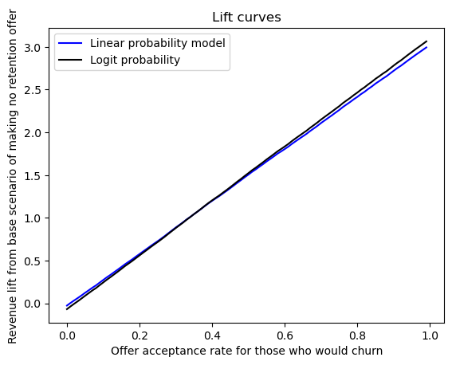
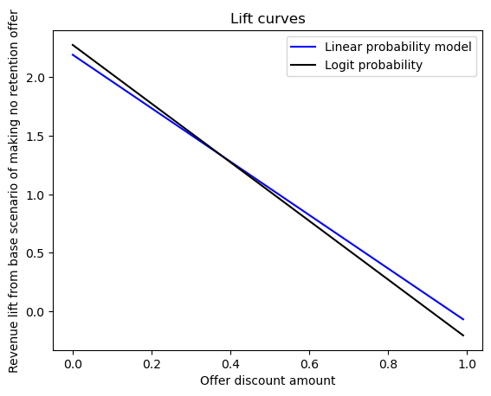
Model performance evaluation
acceptance_rate_nonchurn = 1
acceptance_rate_churn = 0.5
threshold = 0.50
base_price = 4.73 (base pricing scheme in UAE dirham)
discount_amount = 0.3

Slide 22
THANK YOU

